Slide 1
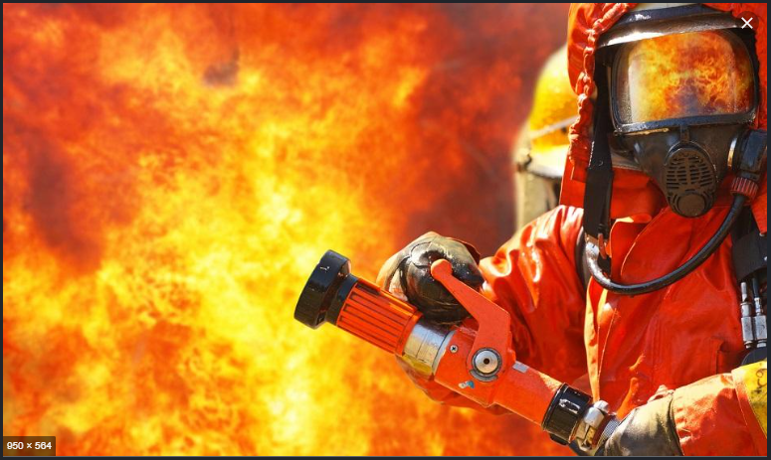
Predicting response time
for
Paris Fire Brigade
Nai Minh Quach
17 octobre 2020
Source: https://www.epsu.org/article/epsu-deplores-tragic-loss-3-italian-firefighters

Slide 2





Presentation
Data
Model
Results
Outlook
Objective
Exploration
Engineering
Benchmark
Catboost
Tuning
Performance
Outliers
Bayesian Modeling

Slide 3



Objective
Regression Task : predict waiting times
3 continuos target variables, Y0, Y1 and Y2
Y0 : Delta selection-departure
Y1 : Delta departure-presentation
Y2 : Delta selection-presentation
Y2 = Y0 + Y1
What: emergency intervention - vehicles
Where: Paris Ile de France
When: 2018, every day, 24h/24h

Slide 4
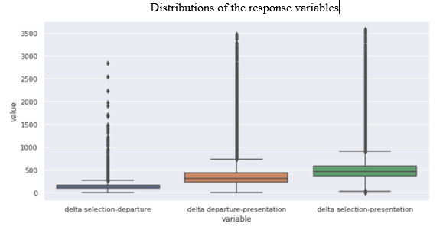
Data Exploration
219 K rows
26 feature variables
No real missing values
Relatively clean
3 response variables
Highly dispersed response times!
Categorical variables with high cardinality

Slide 5
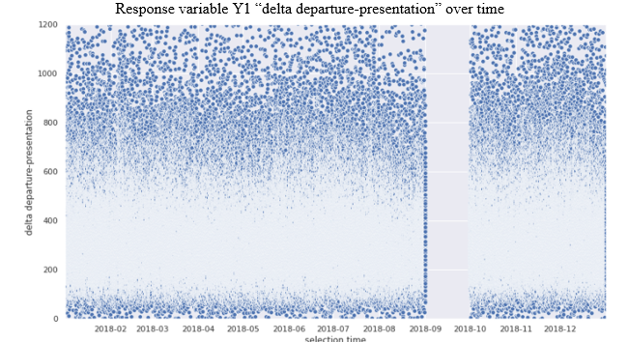
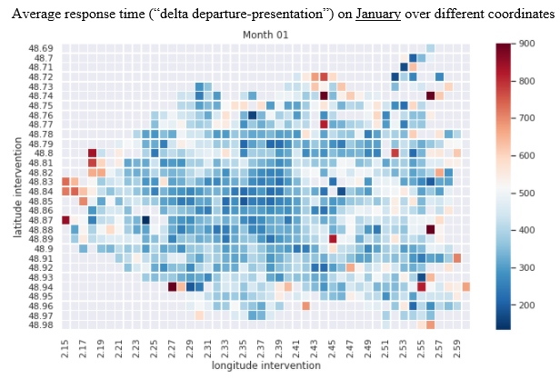
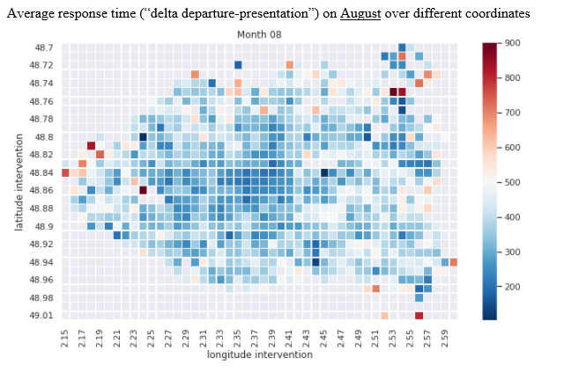
Data Exploration
Data are stationnary in time:

Slide 6
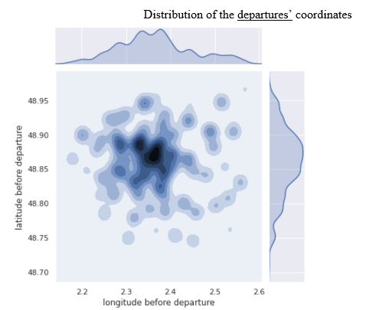
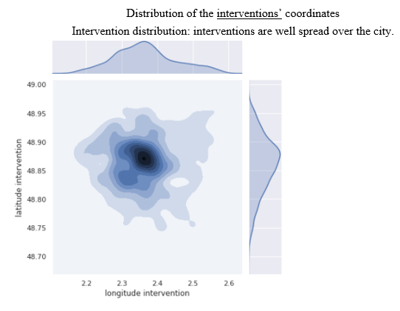
Data Exploration
Departures and Destinations

Slide 7
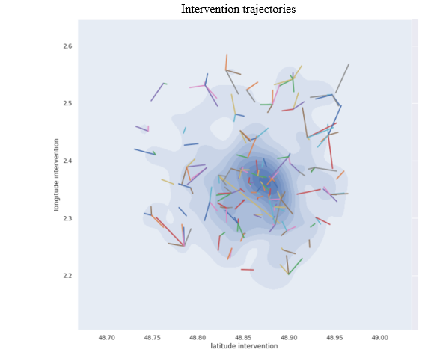
Data Exploration
Trajectories and distances

Slide 8
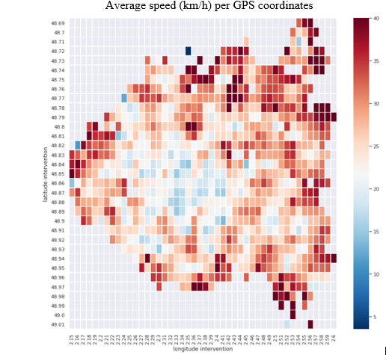
Data Engineering
Creates a map of average speeds

Slide 9


Data Engineering
Some variables are made of list: « GPS Tracking » (json string)
Extract informations from this fields
Total tracked duration
Total tracked distance
Number of steps tracked
Parse and summarize
List of values
These tracking are « missing » in 70% of the time.
There are also list of street names (way-points) => Try to use « Latent Semantic Analysis » to extract insight.

Slide 10
Data Engineering
Classical data derivation
Temporal features: week-day, month, hour, is-holiday, etc
Decomposing strings with multiple words:
« vehicle-type » = {owner} + {vehicle-type}

Slide 11
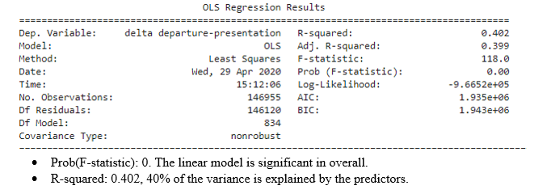
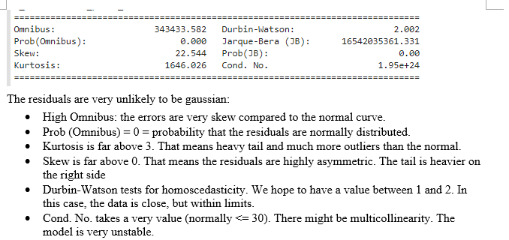
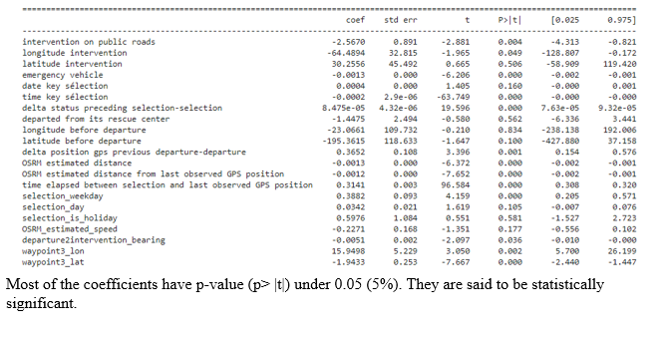
Glance / OLS
OLS model is significant
But normality in error is not verified => MLE is biased

Slide 12
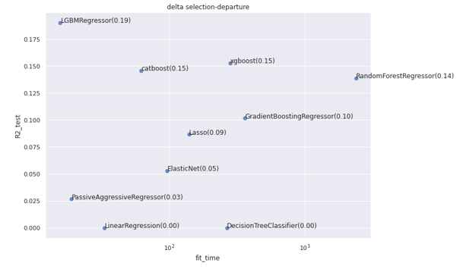
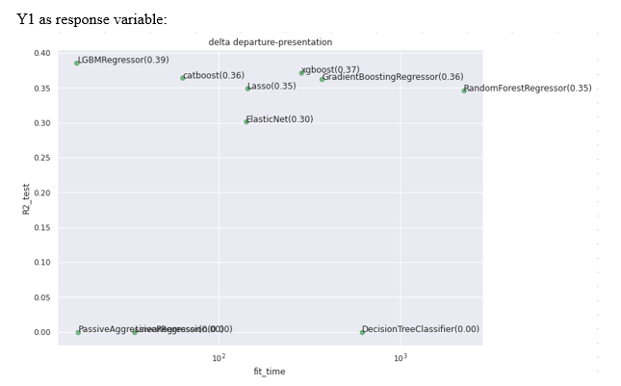
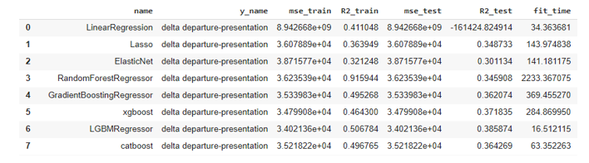
First comparison of models for Y1
Trees methods are the most promising.
With SAP
K2R, R2-test = 0.384 43s in fit time
AGB, R2-test = 0.368 in 80s in fit time

Slide 13
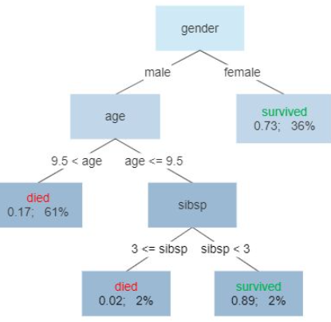



Gradient Boosting
Brief recall about gradient boosting
...
= $\hat{y}=F\left(x\right)$
$$F\left(x\right)= F^{0}\left(x\right)+α h^{2}\left(x\right) + … + α h^{T}(x)$$
Where:
$$F :our model$$
$$x :features$$
$$h^{i}:ith base predictor (learned to minimize the residuals from F^{i−1}\left(x\right))$$
$$α :learning rate$$
Intuitions of why it may work well
No assumptions needed as contrast to linear model,
When the number of trees is high,
if the overfitting can be avoided,
If the base learners are enough « weak learners »
We can expect a model with minimized bias and variance.

Slide 14
Catboost
Why choosing Catboost ?
Handle categorical features with target-statistics-based encoder.
Particularly needful for high cardinality in categorical variable (3K street-names, 700 vehicles, 200 « locations of event »).
One-hot-encoding would cause terrible inefficiency in tree splits,
Innovative « Ordered Target Encoding » to avoid « target leak » issue.
Ordered-boosting to prevent overfitting.
Large avaibility in loss functions.
Reference: https://papers.nips.cc/paper/7898-catboost-unbiased-boosting-with-categorical-features.pdf

Slide 15
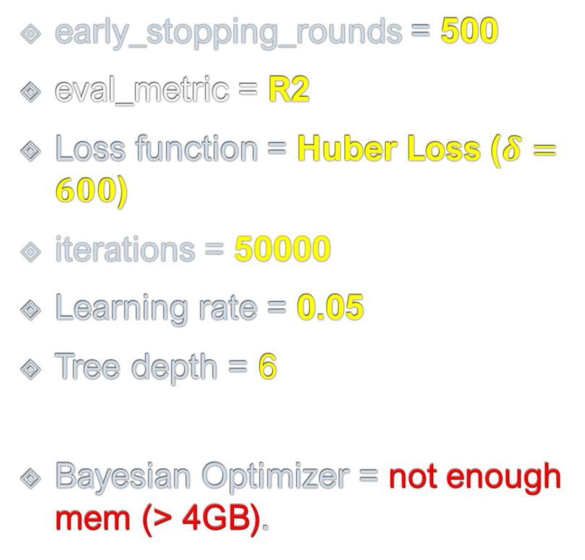
Catboost – strategy in tuning
Combat Overfitting
Early stopping / validation set
Reduce impact of extreme values (outliers)
Loss function
Maximize number of iterations
Max iteration (trees)
Learning rate
Tree depth
Bayesian Optimizer of hyper parameters finding
Gaussian process (GPyOpt)
Tree Parsen Estimator (TPE used by hyperopt)
early_stopping_rounds = 500
eval_metric = R2
Loss function = Huber Loss ($δ=600$)
iterations = 50000
Learning rate = 0.05
Tree depth = 6
Bayesian Optimizer = not enough mem (> 4GB).

Slide 16
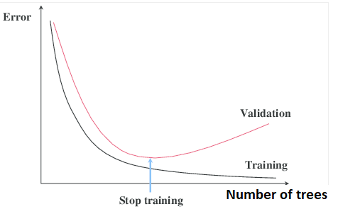
Early stopping
If the performance on validation starts dropping down,
Stop boosting the model

Slide 17
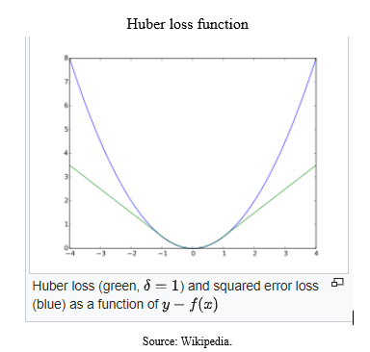
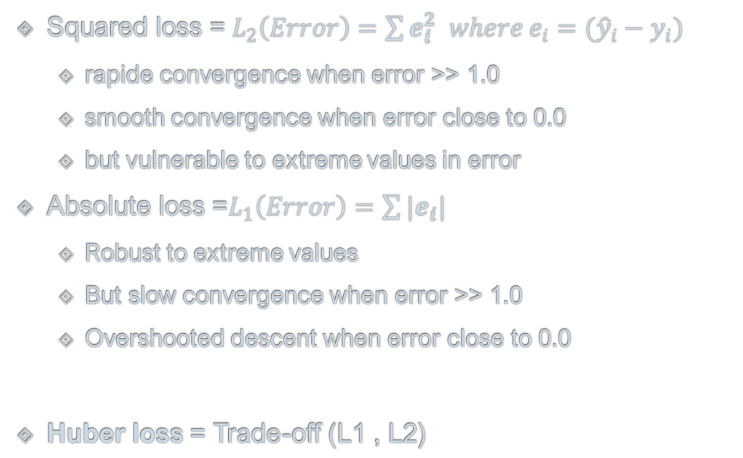
Huber loss
Squared loss =${ L}_{2}\left(Error\right)=\sum{e_{i}^{2} where e_{i}=({\hat{y}}_{i}−y_{i}) }$
rapide convergence when error >> 1.0
smooth convergence when error close to 0.0
but vulnerable to extreme values in error
Absolute loss =$L_{1}\left(Error\right)=\sum{|e_{i}| }$
Robust to extreme values
But slow convergence when error >> 1.0
Overshooted descent when error close to 0.0
Huber loss = Trade-off (L1 , L2)

Slide 18
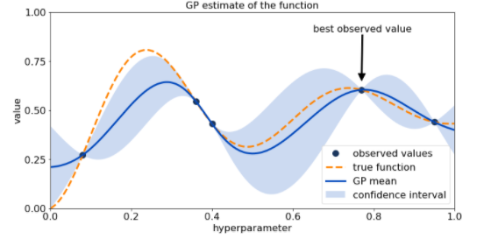
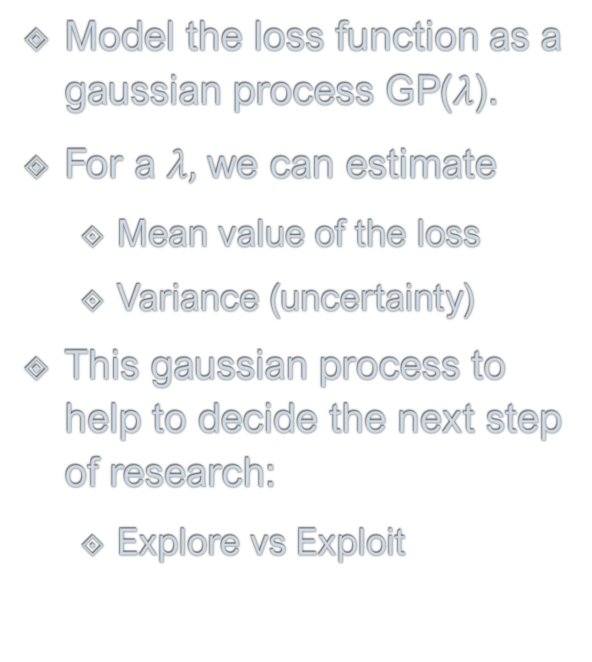
Gaussian Process for hyper param finding
Model the loss function as a gaussian process GP($λ$).
For a $λ,$ we can estimate
Mean value of the loss
Variance (uncertainty)
This gaussian process to help to decide the next step of research:
Explore vs Exploit
https://www.sicara.ai/blog/2019-14-07-determine-network-hyper-parameters-with-bayesian-optimization

Slide 19
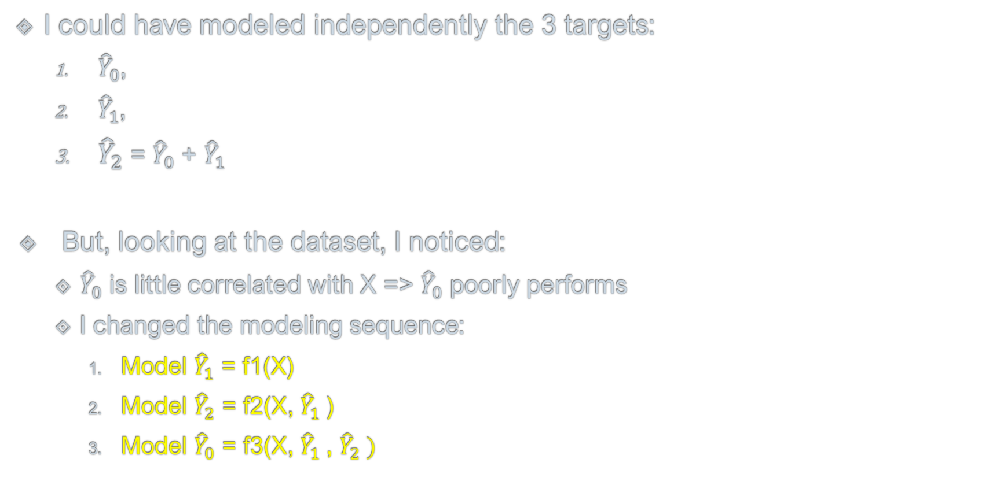
Nested models
I could have modeled independently the 3 targets:
${\hat{Y}}_{0}$,
${\hat{Y}}_{1}$,
${\hat{Y}}_{2}$ = ${\hat{Y}}_{0}$ + ${\hat{Y}}_{1}$
But, looking at the dataset, I noticed:
${\hat{Y}}_{0}$ is little correlated with X => ${\hat{Y}}_{0}$ poorly performs
I changed the modeling sequence:
Model ${\hat{Y}}_{1}$ = f1(X)
Model ${\hat{Y}}_{2}$ = f2(X, ${\hat{Y}}_{1}$)
Model ${\hat{Y}}_{0}$ = f3(X, ${\hat{Y}}_{1}$, ${\hat{Y}}_{2} )$
Y0 : Delta selection-departure
Y1 : Delta departure-presentation
Y2 : Delta selection-presentation
Y2 = Y0 + Y1

Slide 20
The fitted model
Target | Fit time [hour] | Number of trees (best iteration) | R2 / Test
Y0 (delta selection-departure) | 0.53 | 200 | 0.234
Y1 (delta departure-presentation) | 2.10 | 13673 | 0.425
Y2(delta selection-presentation) | 0.47 | 3056 | 0.429
Let’s remind in the first models comparison,
The best R2-test = 0.385
As expected, I got a high number of iterations (> 13K for Y1).

Slide 21
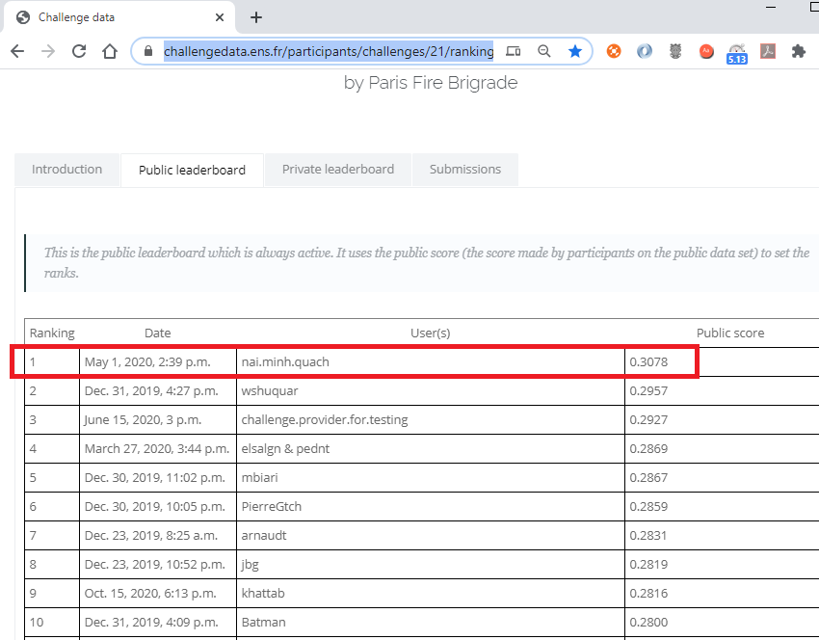

Leaderboard
Screenshot taken at Oct-18-2020
200 contestants
Since June 10, 2019
R2=0.3078 is far from 1.0

Slide 22
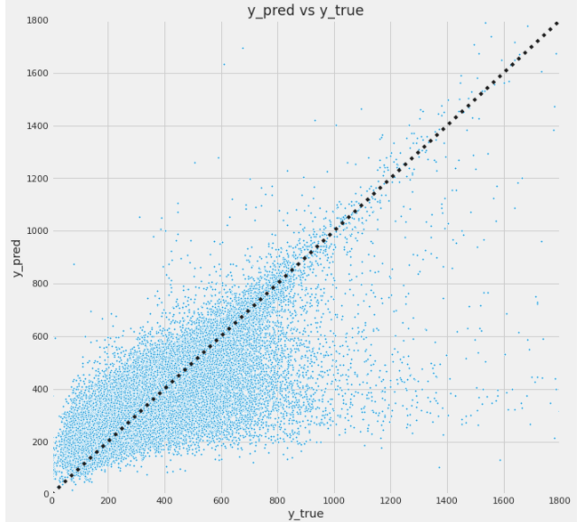
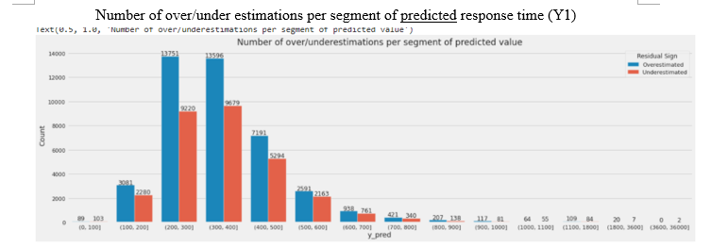
Analyzing the residuals
Are predictions underestimated?
No, the model tends to over-estimate

Slide 23
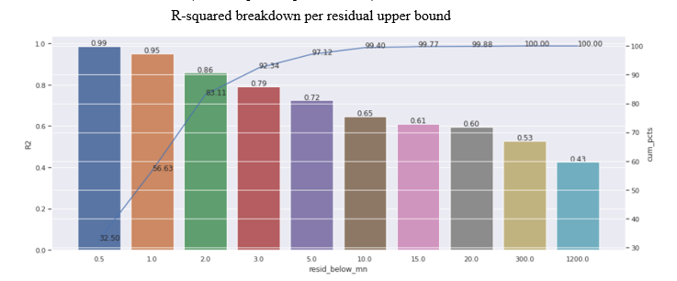
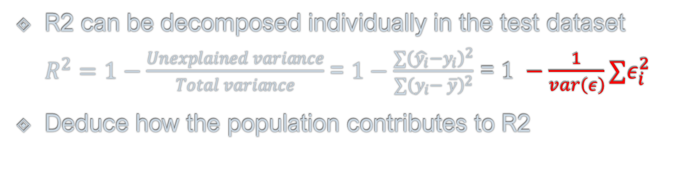
Analyzing R2
R2 can be decomposed individually in the test dataset $R^{2}=1−\frac{Unexplained variance}{Total variance}$ = $1−\frac{∑{\left(\hat{y_{i}}−y_{i}\right)}^{2}}{∑{\left(y_{i}− \overline{y}\right)}^{2}}$ = $1 −\frac{1}{var\left(ε\right)}∑ε_{i}^{2}$
Deduce how the population contributes to R2
If we only considered the population which residuals < 2 minutes,
that represents 83 % of the total population,
R2 = 0.86
Only a litttle portion of individuals (<=14%) are responsible of 50% drop in R2.

Slide 24
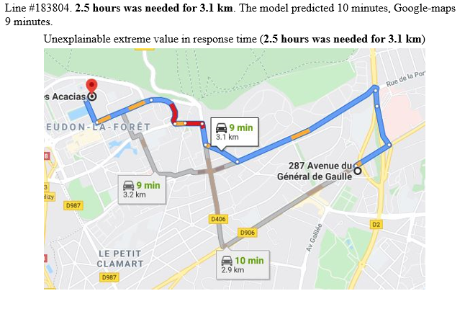
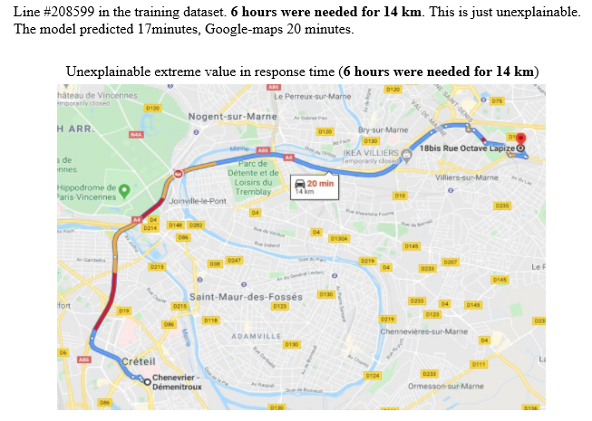
Examples of outliers

Slide 25
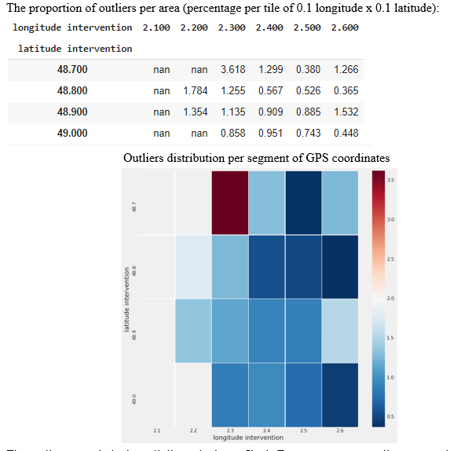
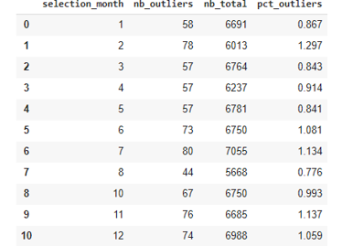
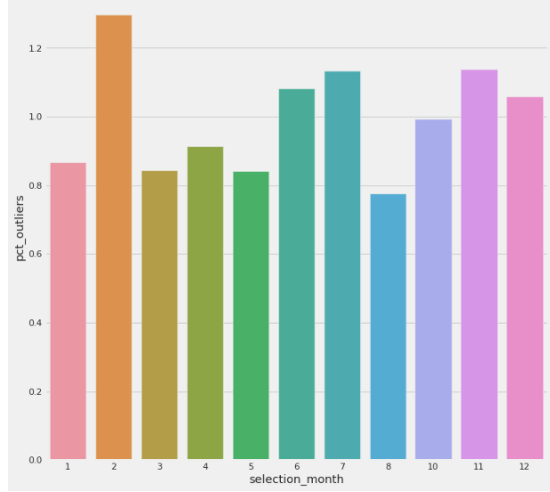
Outliers distribution time vs location
Outliets = examples with residuals > 3 x std(residuals)
Distribution by month of year

Slide 26
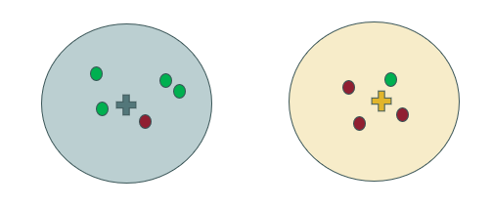
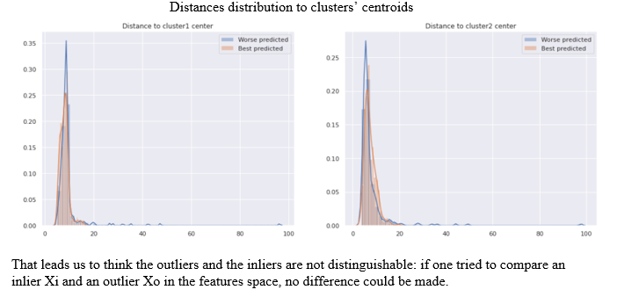
Are Outliers disguisable?
Use K-mean to find 2 clusters in the dataset,
See if the outliers are uniformly distanciated from the 2 centroids,
For example, the red points are outliers,
I want if the outliers are generally closer to one cluster.

Slide 27
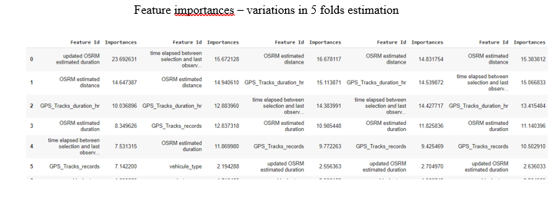
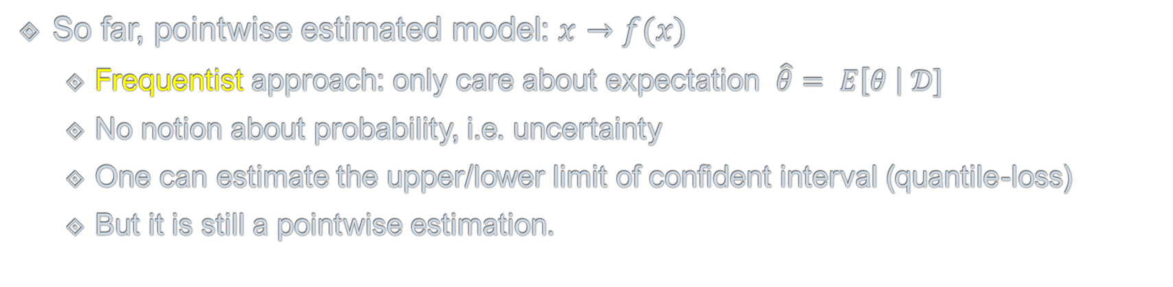
Frequentist approach
So far, pointwise estimated model: $x→f(x)$
Frequentist approach: only care about expectation $\hat{θ}= E\left[θ \right| 𝒟]$
No notion about probability, i.e. uncertainty
One can estimate the upper/lower limit of confident interval (quantile-loss)
But it is still a pointwise estimation.

Slide 28
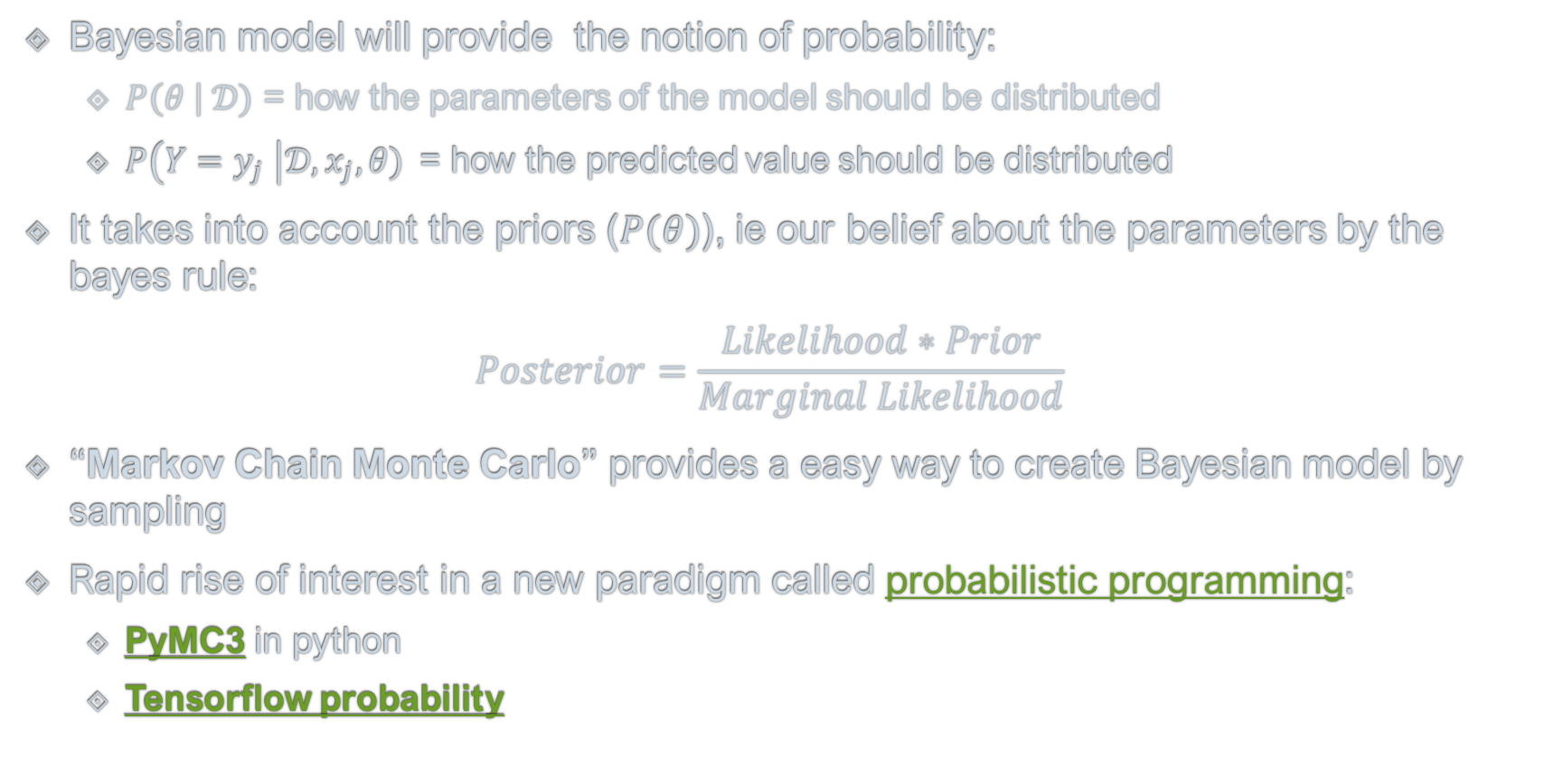
Bayesian Model
Bayesian model will provide the notion of probability:
$P\left(θ \right| 𝒟)$ = how the parameters of the model should be distributed
$P\left(Y=y_{j} \right|𝒟, x_{j}, θ)$= how the predicted value should be distributed
It takes into account the priors ($P(θ)$), ie our belief about the parameters by the bayes rule:
$$Posterior=\frac{Likelihood∗Prior}{Marginal Likelihood}$$
“Markov Chain Monte Carlo” provides a easy way to create Bayesian model by sampling
Rapid rise of interest in a new paradigm called probabilistic programming:
PyMC3 in python
Tensorflow probability

Slide 29
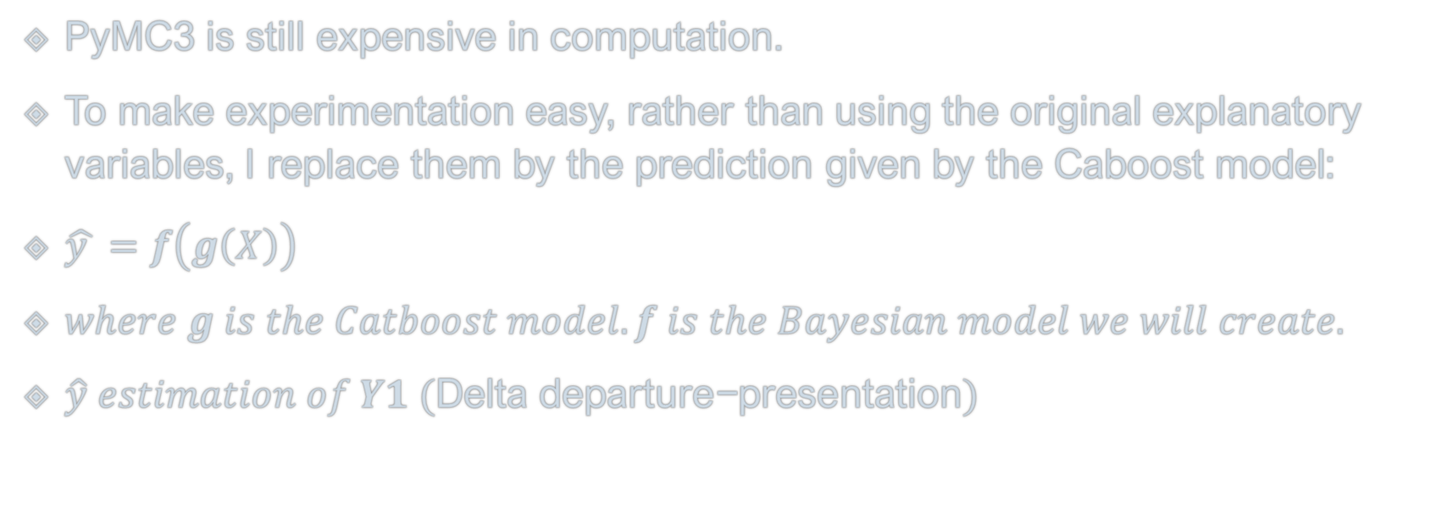
Simplified model with PyMC3
PyMC3 is still expensive in computation.
To make experimentation easy, rather than using the original explanatory variables, I replace them by the prediction given by the Caboost model:
$\hat{y }=f\left(g\left(X\right)\right)$
$where g is the Catboost model. f is the Bayesian model we will create.$
$\hat{y} estimation of Y1 (\text{Delta} \text{departure}\text{−}\text{presentation})$

Slide 30
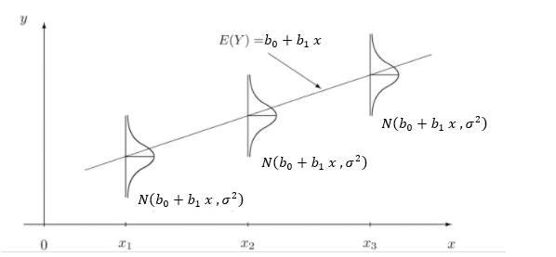
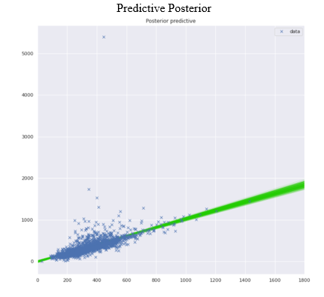
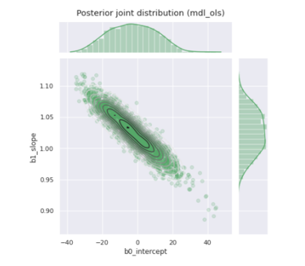
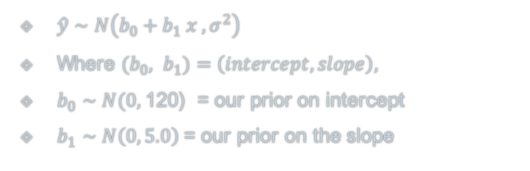
Simplest OLS as Bayesian Model
$\hat{y}∼N\left(b_{0}+b_{1} x , σ^{2}\right)$
Where ${(b}_{0}, b_{1})=\left(intercept, slope\right),$
$b_{0}∼N(0,$120) = our prior on intercept
$b_{1}∼N\left(0, 5.0\right)$= our prior on the slope

Slide 31
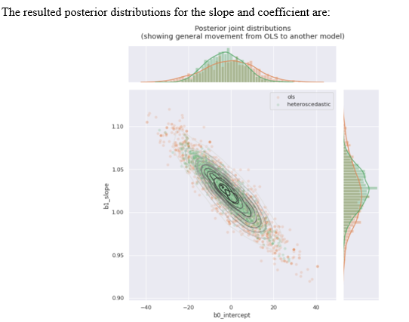
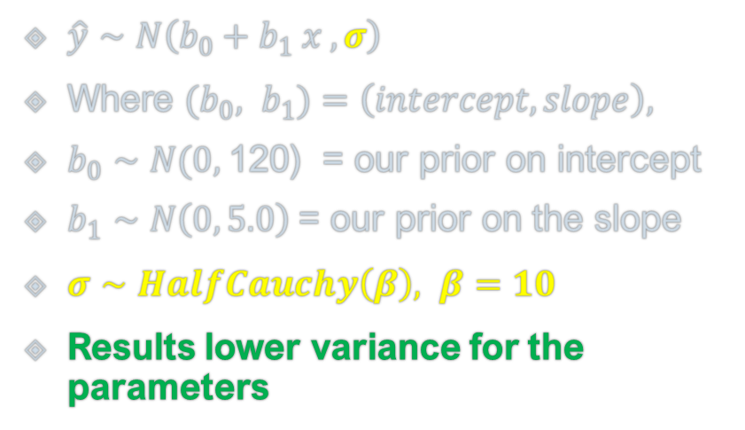
2nd OLS - Heteroscedastic
$\hat{y}∼N\left(b_{0}+b_{1} x , σ\right)$
Where ${(b}_{0}, b_{1})=\left(intercept, slope\right),$
$b_{0}∼N(0,$120) = our prior on intercept
$b_{1}∼N\left(0, 5.0\right)$= our prior on the slope
$σ∼HalfCauchy\left(β\right), β=10$
Results lower variance for the parameters

Slide 32
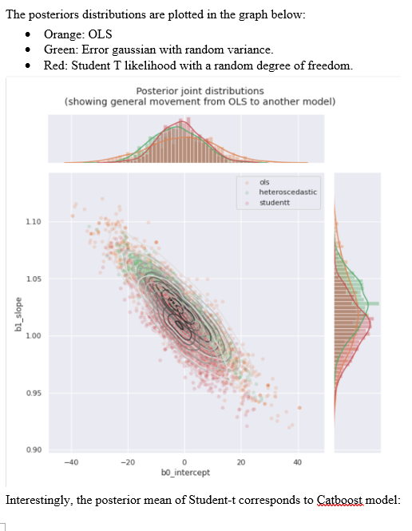
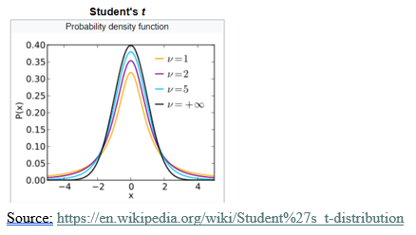
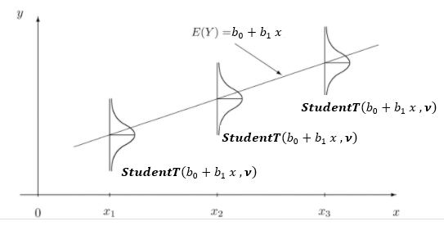

3thd Model High Kurtosis errors
$$\hat{y}∼StudentT\left(b_{0}+b_{1} x ,ν\right)$$

Slide 33
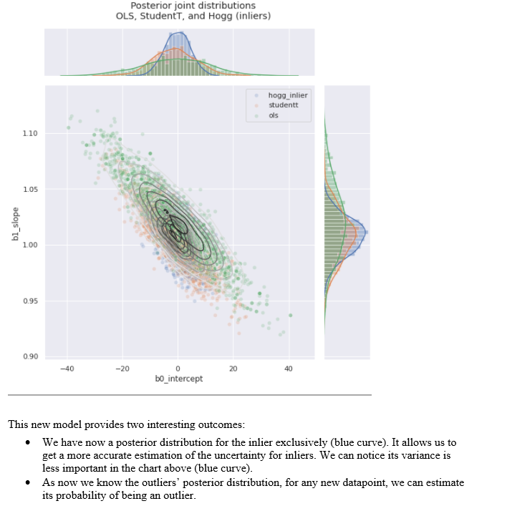
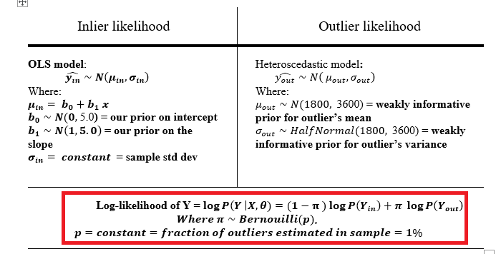
4th model – Hogg model

Slide 34

Hogg model Posterior Predictive Distribution
The outliers are now directly reconized
by the model (red points)

Slide 35
Conclusion

